Slide 1
Introduction to NLP
Semantic Parsing

Slide 2
Introduction to NLP
First Order Logic

Slide 3
Semantics
What is the meaning of: (5+2)*(4+3)?
Parse tree
49
E
E
F
E
E
F
E
*
E
F
E
N
+
N
N
+
N
5
2
4
3
Notes:
This slide and the next two slides are from 361

Slide 4
Semantics
What if we had (5+2)*(4+z)?
mult(add(5,2),add(4,z))
E
E
F
E
E
F
E
*
E
F
E
N
+
N
N
+
N
5
2
4
z

Slide 5
What about (English) sentences?
Every human is mortal.
??

Slide 6
Representing Meaning
Goal
Capturing the meaning of linguistic utterances using formal notation
Linguistic meaning
“It is 8 pm”
Pragmatic meaning
“It is time to leave”
Semantic analysis:
Assign each word a meaning
Combine the meanings of words into sentences
I bought a book: ∃ x,y: Buying(x) ^ Buyer(speaker,x) ^ BoughtItem(y,x) ^ Book(y)
Buying (Buyer=speaker, BoughtItem=book)

Slide 7
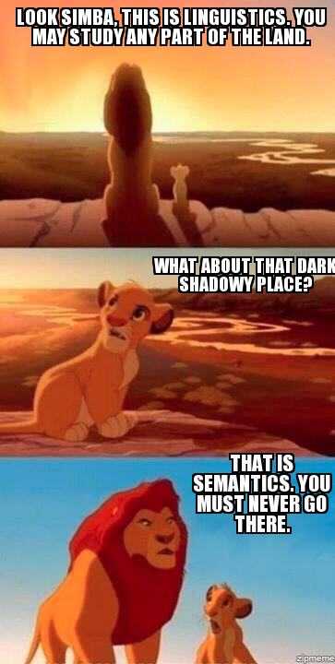

Slide 8
Properties of Propositional Logic
Pros
Compositional
Declarative
Cons
Limited expressive power
Represents facts

Slide 9
First Order Logic
Used to represent
Objects – Martin the cat
Relations – Martin and Moses are brothers
Functions – Martin’s age

Slide 10
First Order Logic
Formula → AtomicFormula | Formula Connective Formula
| Quantifier Variable Formula | ¬ Formula | (Formula)
AtomicFormula → Predicate (Term…)
Term → Function (Term…) | Constant | Variable
Connective → ∧ | ⋁ | ⇒
Quantifier → ∀ | ∃
Constant → M | Martin
Variable → x | y | …
Predicate → Likes | Eats | …
Function → AgeOf | ColorOf | …

Slide 11
Common Mistake (1)
⇒ is the main connective with ∀
Common mistake: using ∧ as the main connective with ∀:
∀x Cat(x) ∧ EatsFish(x)
means “Everyone is a cat and everyone eats fish”

Slide 12
Common Mistake (2)
∧ is the main connective with ∃
Common mistake: using ⇒ as the main connective with ∃:
∃x Cat(x) ⇒ EatsFish(x)
is true if there is anyone who is not a cat!

Slide 13
First Order Logic
NACLO problem from 2014
Author: Ben King
http://www.nacloweb.org/resources/problems/2014/N2014-H.pdf
http://www.nacloweb.org/resources/problems/2014/N2014-HS.pdf

Slide 14
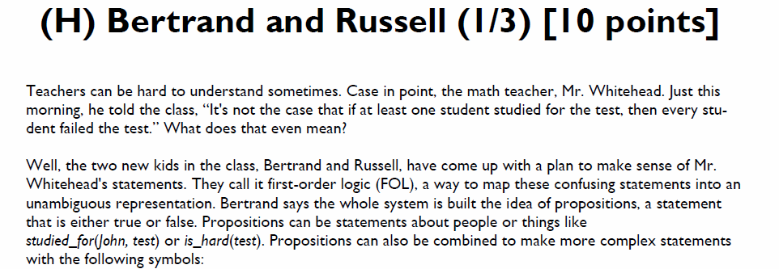
First Order Logic

Slide 15
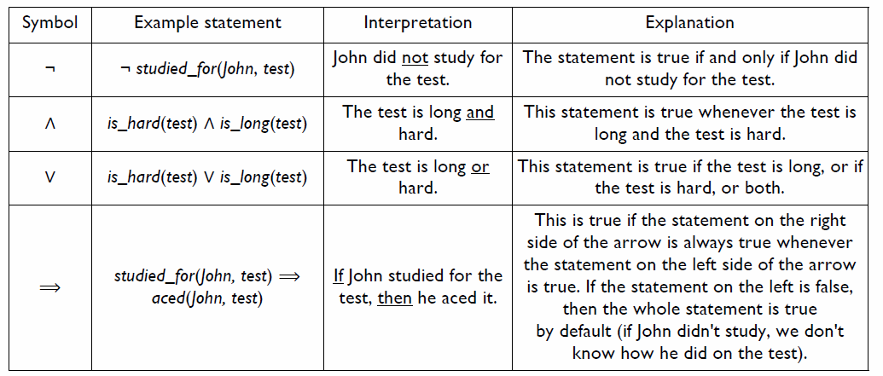

Slide 16
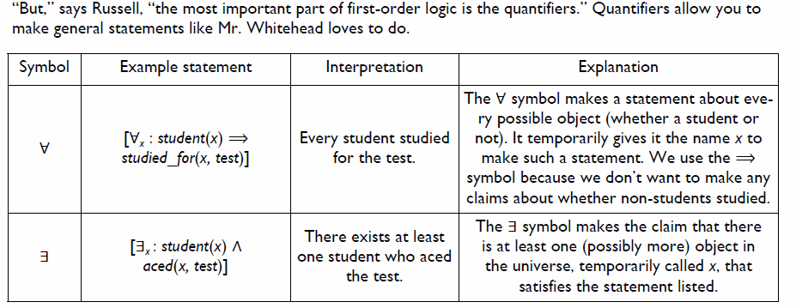

Slide 17
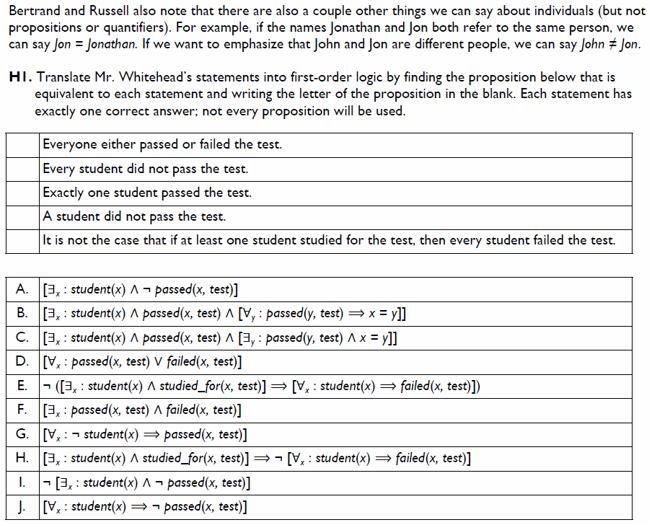

Slide 18
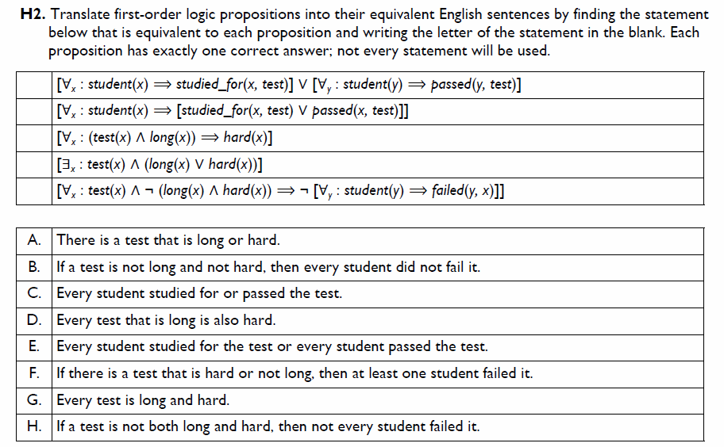

Slide 19
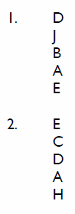
Solutions

Slide 20
Types
Base types
e (entity) – objects
t (truth values)
Complex types
If a is a type and b is a type, then a→b is a type.
(a→b)(a)=b
Example
Type of Mary = e
Type of sleeps = e→t
Type of sleeps(Mary) = t
Type of ^ = t→t
Type of ^(sleeps(Mary)) = t
* ^(sleeps) - not well typed

Slide 21
Lambda Expressions
Example
inc(x) = λx x+1
then inc(4) = (λx x+1)(4) = 5
Example
add(x,y) = λx,λy(x+y)
then add(3,4) = (λx,λy(x+y))(3)(4)= (λy 3+y)(4) = 3+4 = 7
Useful for semantic parsing (see later)

Slide 22
Lambda Expressions
λx.like(x,Mary)
λx.like(Mary,x)
λx.(λy.like(x,y))
λP.P(Mary)
property is true of Mary

Slide 23
Lambda Expressions
[λx.sleeps(x)](Mary)=sleeps(Mary)
[λx.likes(Mary,x)](John)=likes(Mary,John)
[λx.likes(x,y)](Mary)=likes(Mary,Mary)

Slide 24
Example
Input
Javier likes pizza
Output
like(Javier, pizza)

Slide 25
Example
S -> NP VP {VP.Sem(NP.Sem)} t
VP -> V NP {V.Sem(NP.Sem)} <e,t>
NP -> N {N.Sem} e
V -> likes {λ x,y likes(x,y) <e,<e,t>>
N -> Javier {Javier} e
N -> pizza {pizza} e

Slide 26
Semantic Parsing (preview)
Associate a semantic expression with each node
S: likes(Javier, pizza)
N: Javier
VP: λx likes(x,pizza)
Javier
V: λ x,y likes(x,y)
N: pizza
likes
pizza

Slide 27
Semantic Parsing
Converting natural language to a logical form
e.g., executable code for a specific application
Example:
Airline reservations
Geographical query systems

Slide 28
Stages of Semantic Parsing
Input
Sentence
Syntactic Analysis
Syntactic structure
Semantic Analysis
Semantic representation

Slide 29
Compositional Semantics
Add semantic attachments to CFG rules
Compositional semantics
Parse the sentence syntactically
Associate some semantics to each word
Combine the semantics of words and non-terminals recursively
Until the root of the sentence

Slide 30
Example
Input
Javier likes pizza
Output
like(Javier, pizza)

Slide 31
Example
S -> NP VP {VP.Sem(NP.Sem)} t
VP -> V NP {V.Sem(NP.Sem)} <e,t>
NP -> N {N.Sem} e
V -> likes {λ x,y likes(x,y) <e,<e,t>>
N -> Javier {Javier} e
N -> pizza {pizza} e

Slide 32
Semantic Parsing
Associate a semantic expression with each node
S: likes(Javier, pizza)
N: Javier
VP: λx likes(x,pizza)
Javier
V: λ x,y likes(x,y)
N: pizza
likes
pizza

Slide 33
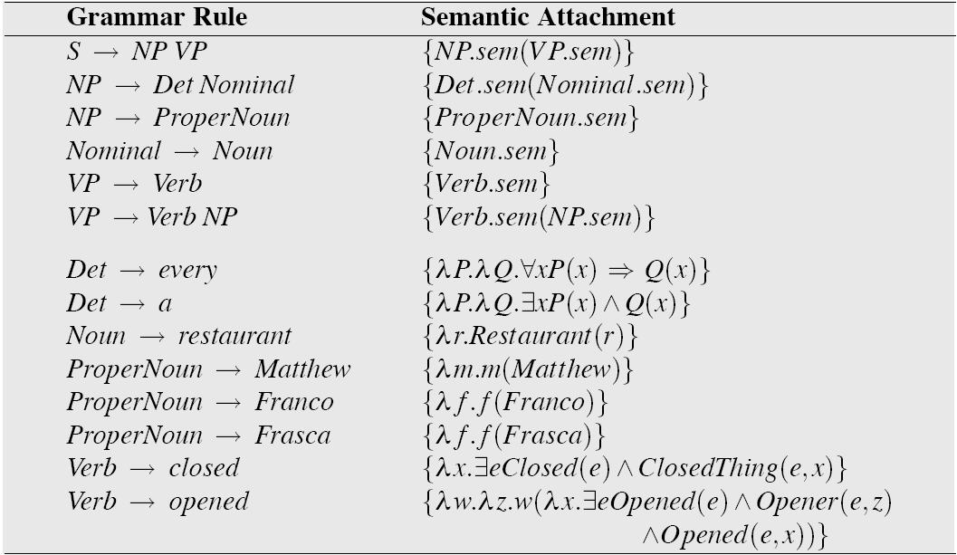
Grammar with Semantic Attachments
Example from Jurafsky and Martin

Slide 34
Using CCG (Steedman 1996)
CCG representations for semantics
ADJ: λx.tall(x)
(S\NP)/ADJ : λf.λx.f(x)
NP: YaoMing
YaoMing is tall
NP (S\NP)/ADJ ADJ
YaoMing λf.λx.f(x) λx.tall(x)
>
S\NP
λx.tall(x)
<
S
Tall (YaoMing)
Notes:
This slide appears in another file.

Slide 35
CCG Parsing
Example:
https://bitbucket.org/yoavartzi/spf
Tutorial by Artzi, FitzGerald, Zettlemoyer
http://yoavartzi.com/pub/afz-tutorial.acl.2013.pdf

Slide 36
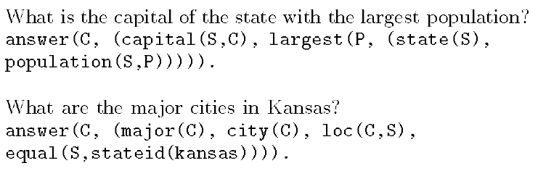
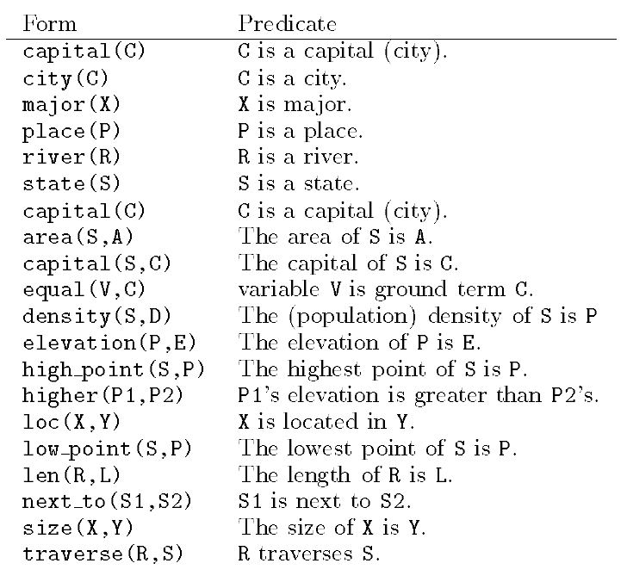
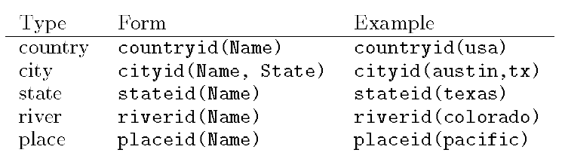
GeoQuery (Zelle and Mooney 1996)

Slide 37
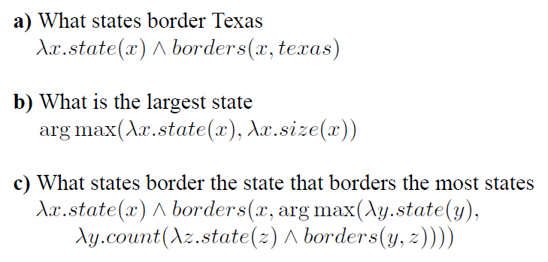
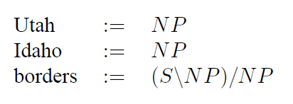
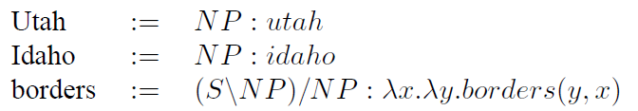
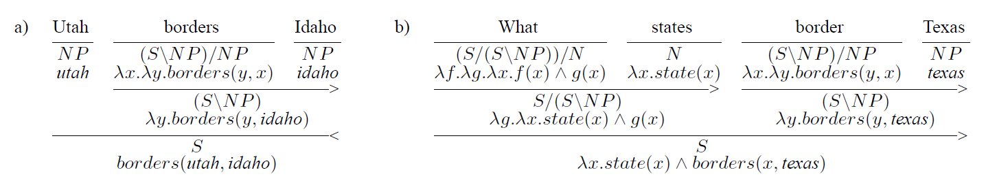
Zettlemoyer and Collins (2005)

Slide 38
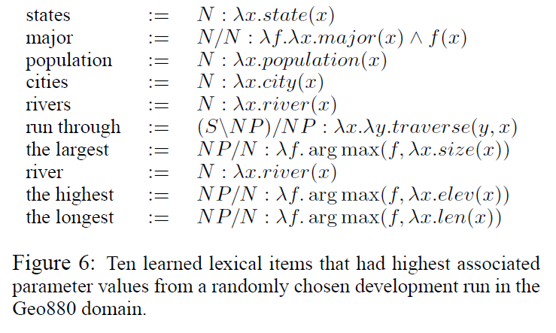
Zettlemoyer and Collins (2005)

Slide 39
Zettlemoyer and Collins (2005)
PCCG learning
Lexicon Λ, parameter vector θ
GENLEX

Slide 40
[Neubig 2017]

Slide 41
[Jia and Liang 2016]

Slide 42
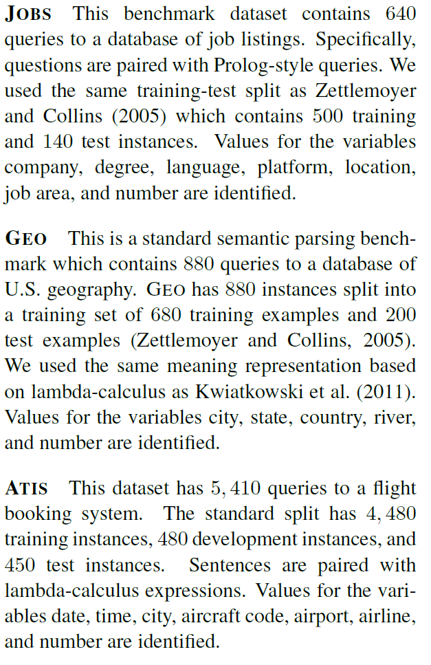
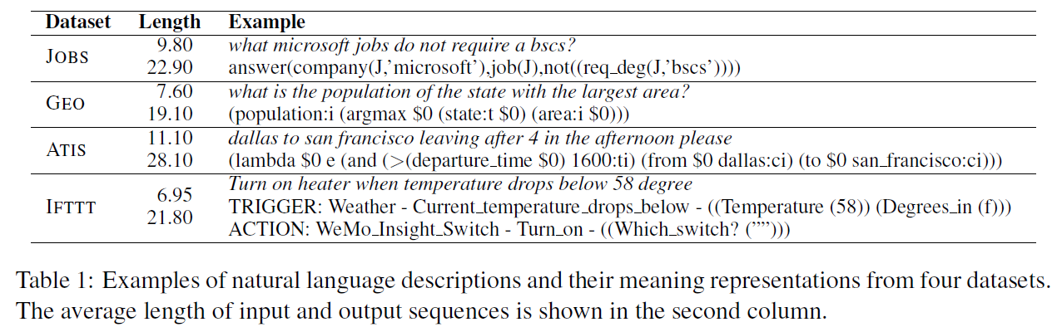
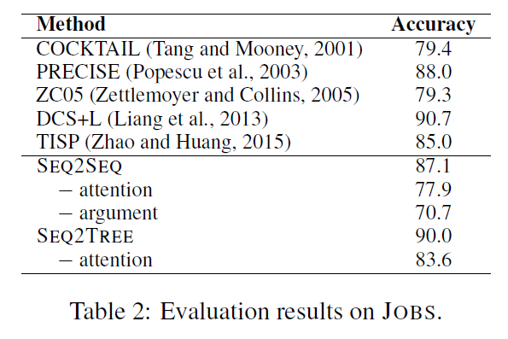
Dong and Lapata (2016)

Slide 43
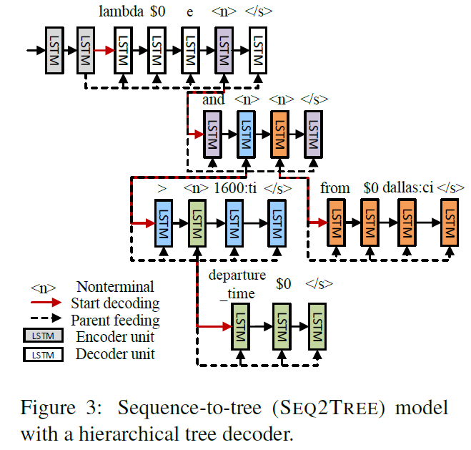
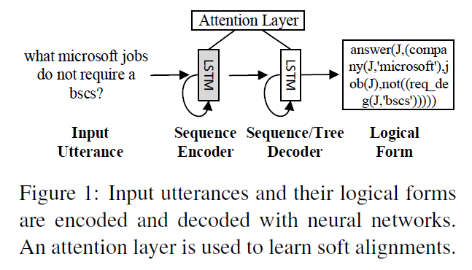
Dong and Lapata (2016)

Slide 44
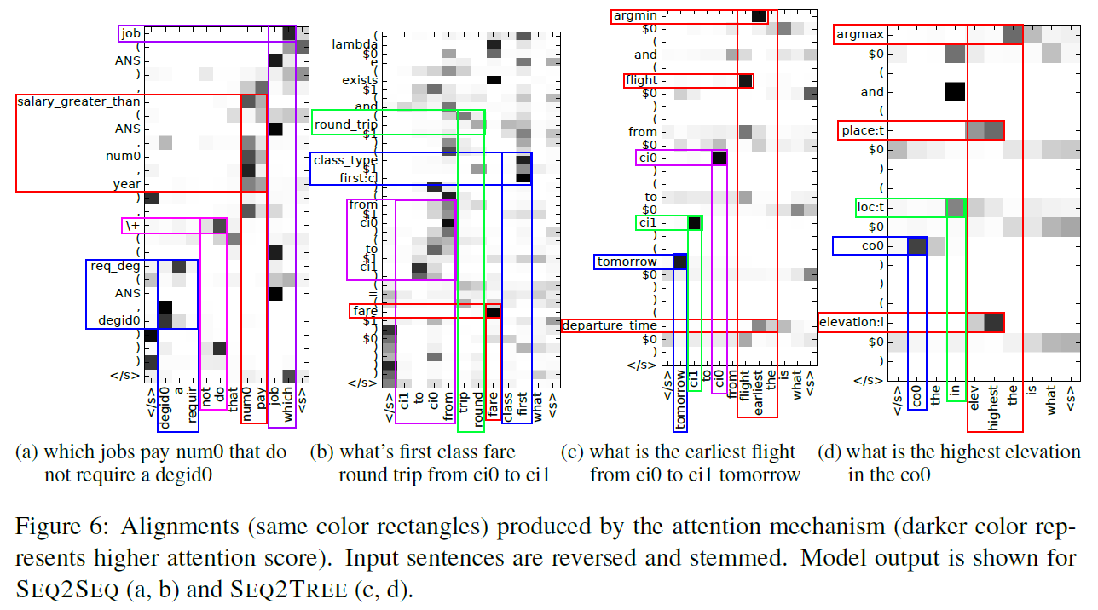
Dong and Lapata (2016)

Slide 45
Dong and Lapata (2018)

Slide 46
Dong and Lapata 2018

Slide 47
Dong and Lapata 2018

Slide 48
Introduction to NLP
Abstract Meaning Representation

Slide 49
Abstract Meaning Representation (AMR)
http://amr.isi.edu/
Single structure that includes:
Predicate-Argument Structure
Named Entity Recognition
Coreference Resolution
Wikification
[slide from Jonathan Kummerfeld]

Slide 50
Example
“Lassie ate four bones that she found.”
e / eat-01
Arg-0
Arg-1
a / animal
Arg-0
f / find-01
Arg-1
b / bone
n / name
wiki: “Lassie”
4
“Lassie”
[slide from Jonathan Kummerfeld]

Slide 51
Example
About 14,000 people fled their homes at the weekend after a local tsunami warning was issued, the UN said on its Web site
(s / say-01
:ARG0 (g / organization
:name (n / name
:op1 "UN"))
:ARG1 (f / flee-01
:ARG0 (p / person
:quant (a / about
:op1 14000))
:ARG1 (h / home :poss p)
:time (w / weekend)
:time (a2 / after
:op1 (w2 / warn-01
:ARG1 (t / tsunami)
:location (l / local))))
:medium (s2 / site
:poss g
:mod (w3 / web)))

Slide 52
Status of AMR
AMR currently lacks
Multilingual consideration
Quantifier scope
Co-references across sentences
Grammatical number, tense, aspect, quotation marks
Many noun-noun or noun-adjective relations
Many detailed frames, e.g. Earthquake (with roles for magnitude, epicenter, casualties, etc)
[slide from Jonathan Kummerfeld]

Slide 53
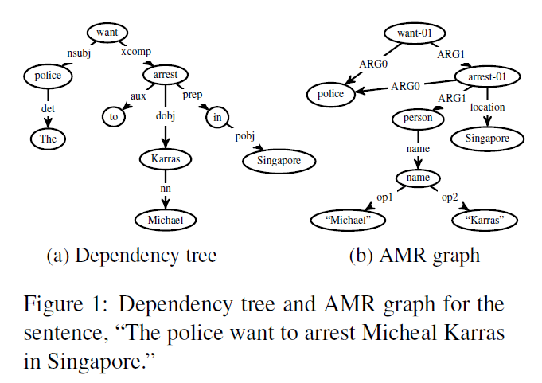
AMR Parsing (Wang et al. 2015,16)

Slide 54
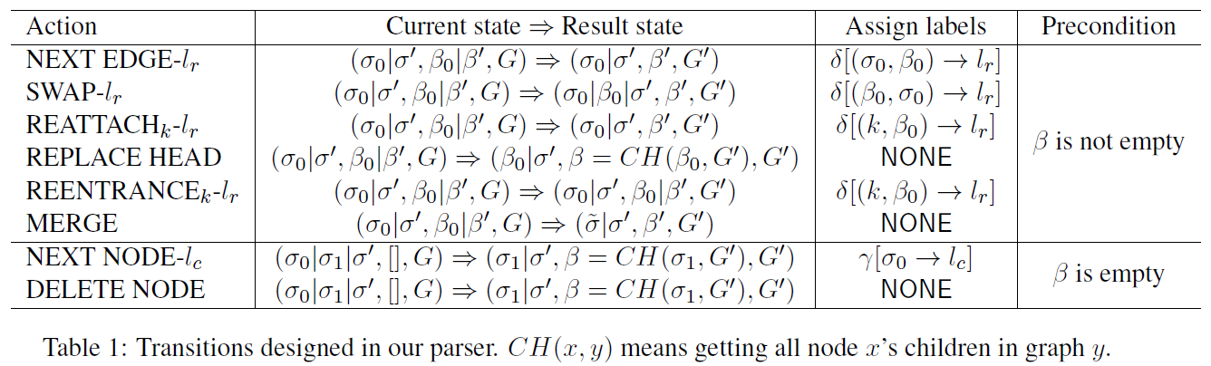
AMR Parsing (Wang et al. 2015,16)

Slide 55
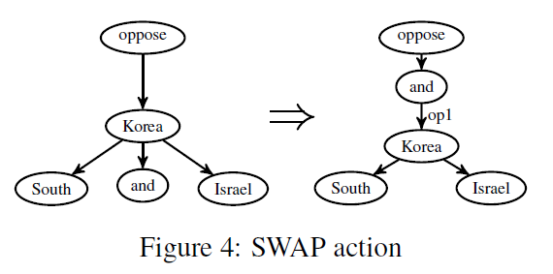
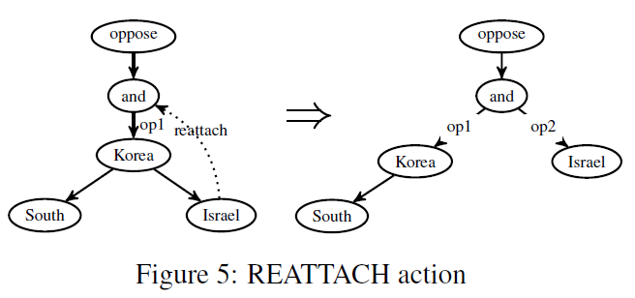
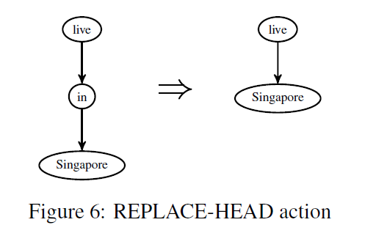
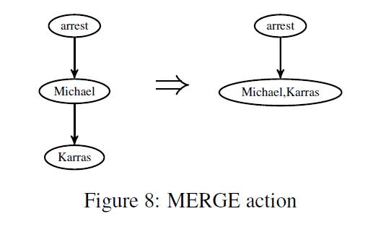
AMR Parsing (Wang et al. 2015,16)

Slide 56
Introduction to NLP
Natural Language to SQL

Slide 57
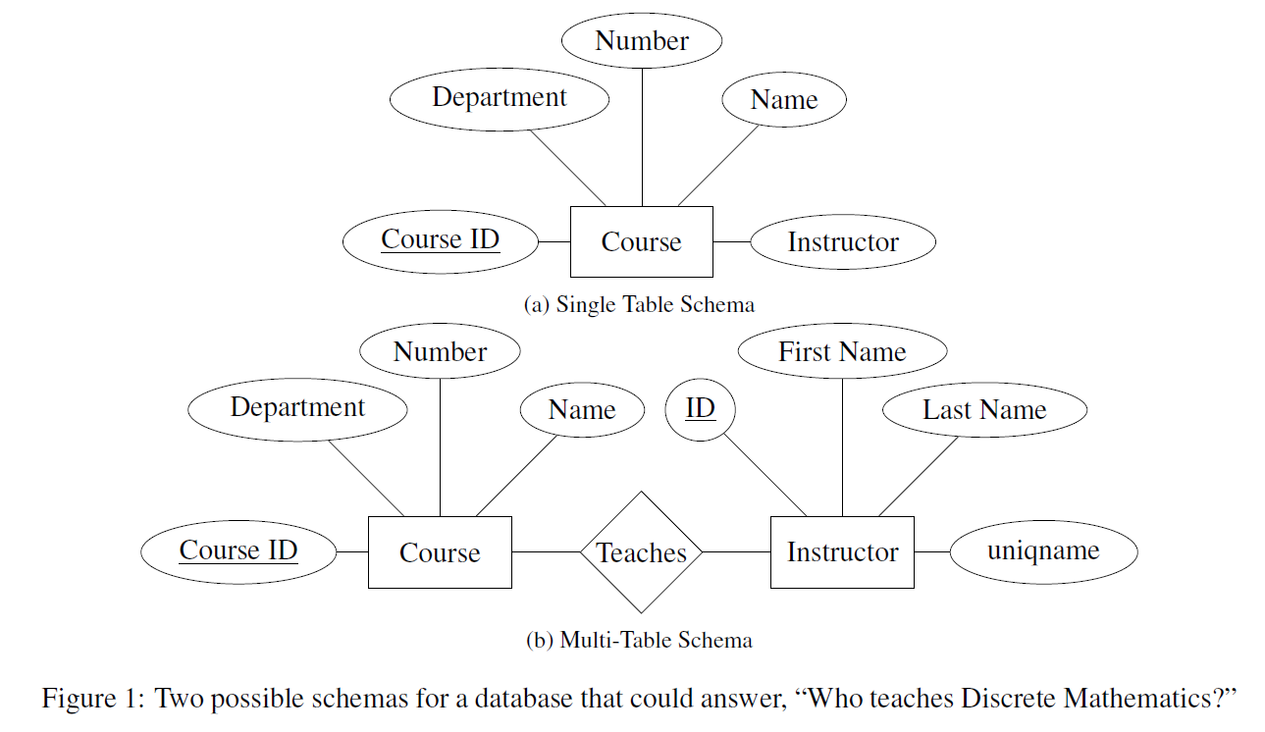
NL to SQL
[Finegan-Dollak et al]

Slide 58

Example: Text-to-SQL
SELECT I.NAME
FROM INSTRUCTOR AS I,
OFFERING_INSTRUCTOR AS OI,
COURSE_OFFERING AS O, SEMESTER AS S, COURSE AS C
WHERE OI.INSTRUCTOR_ID=I.INSTRUCTOR_ID
AND O.OFFERING_ID=OI.OFFERING_ID
AND O.SEMESTER=S.SEMESTER_ID
AND O.COURSE_ID=C.COURSE_ID
AND C.NAME=”NLP"
AND S.YEAR=2016 AND S.SEMESTER="FA"
“Who teaches NLP?”
Notes:
SQL is a programming language for interacting with relational databases.
We’re primarily interested today in SQL queries, which are used to retrieve specific information from the database. Interestingly, the way to express a natural language question as a SQL query depends on something called the schema of the database

Slide 59
All About SQL
Course
Instructor
Course ID | Dept. | Number | Name | Credits
1 | EECS | 203 | Discrete Math | 4
2 | LING | 137 | Epic Grammar Fails | 3
3 | EECS | 595 | NLP | 4
Instructor ID | First Name | Last Name
1 | Dragomir | Radev
2 | Walter | Lasecki
3 | Ezra | Keshet
4 | Rada | Mihalcea
Course Offering
Course ID | Instructor ID | Year | Semester
3 | 1 | 2016 | Fall
3 | 4 | 2017 | Fall
2 | 3 | 2018 | Winter
SELECT C.CREDITS
FROM COURSE AS C
WHERE C.NAME = “NLP”;
How many credits is NLP?

Slide 60
All About SQL
Course
Instructor
Instructor ID | First Name | Last Name
1 | Dragomir | Radev
2 | Walter | Lasecki
3 | Ezra | Keshet
4 | Rada | Mihalcea
Course ID | Dept. | Number | Name | Credits
1 | EECS | 203 | Discrete Math | 4
2 | LING | 137 | Epic Grammar Fails | 3
3 | EECS | 595 | NLP | 4
Course Offering
SELECT I.FIRST_NAME, I.LAST_NAME
FROM INSTRUCTOR AS I,
COURSE AS C,
COURSE_OFFERING AS CO
WHERE C.NAME = “NLP”
AND C.COURSE_ID = CO.COURSE_ID AND CO.INSTRUCTOR_ID =
I.INSTRUCTOR_ID;
Course ID | Instructor ID | Year | Semester
3 | 1 | 2016 | Fall
3 | 4 | 2017 | Fall
2 | 3 | 2018 | Winter
Who teaches NLP?

Slide 61
All About SQL
Course
Instructor
Course ID | Dept. | Number | Name | Credits
1 | EECS | 203 | Discrete Math | 4
2 | LING | 137 | Epic Grammar Fails | 3
3 | EECS | 595 | NLP | 4
Instructor ID | First Name | Last Name
1 | Dragomir | Radev
2 | Walter | Lasecki
3 | Ezra | Keshet
4 | Rada | Mihalcea
Course Offering
Course ID | Instructor ID | Year | Semester
3 | 1 | 2016 | Fall
3 | 4 | 2017 | Fall
2 | 3 | 2018 | Winter
SELECT C1.NAME
FROM COURSE AS C1
WHERE C1.CREDITS =
(SELECT MAX C2.CREDITS
FROM COURSE AS C2);
What course is worth the most credits?

Slide 62
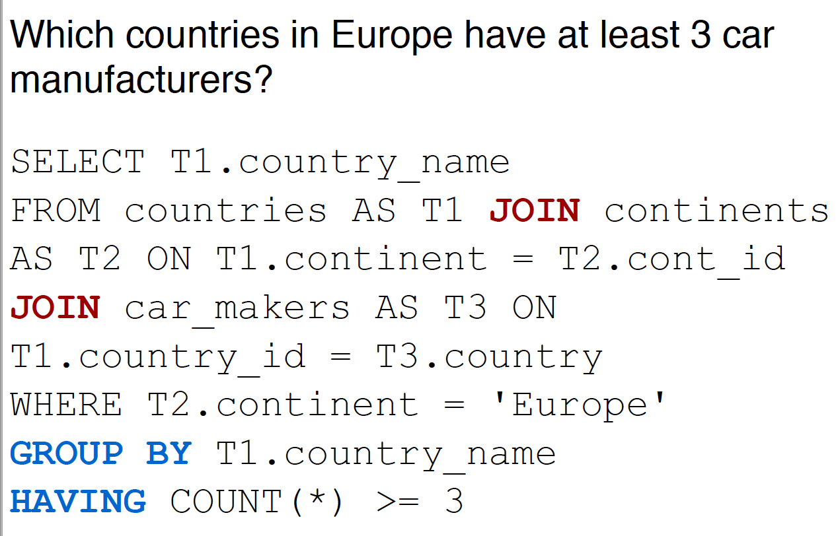
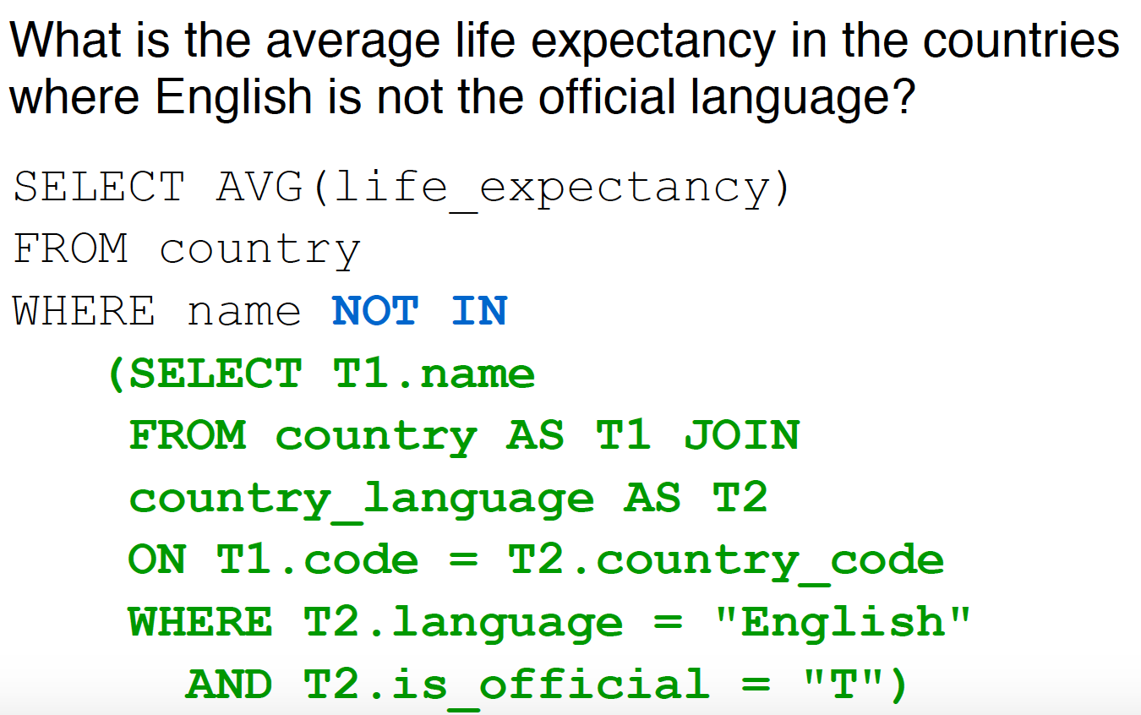
More Complicated SQL

Slide 63
CACM 1978

Slide 64
NLIDB Early Work
Very early work hand-engineered QA systems for specific databases (e.g., Lunar, Woods et al. 1972)
Precise (Popescu et al., 2004): Syntax-based, high precision, only a limited class of questions
The DB community has tried pattern matching and grammar-based methods; (e.g., Li & Jagadish 2014—grammar based + user feedback)
Transfer of techniques from logical semantic parsing (e.g., Poon 2013; Iyer et al. 2017)
Skip SQL with end-to-end systems (Yin et al. 2016, Neelakantan et al. 2017)

Slide 65
Limitations of Early Work
Very limited vocabulary
No machine learning
Lots of rules
Syntactic parsing
Overfitting
No distinction between training and testing data
The output was not SQL
introduced 1974, standardized 1986

Slide 66


Slide 67
Seq2SQL datasets are scarce!
Compared to other large datasets such as ImageNet for object recognition, building a decent seq2SQL dataset is even more time-consuming
Hard to find many databases with multiple tables online
Annotation requires very specific knowledge in databases

Slide 68
Traditional Seq2SQL datasets
Traditional 9 seq2SQL datasets: ATIS, Geo, Scholar, etc. + Advising
Pros
SQL queries cover complex SQL structures and components
Cons
The number of labeled queries is small (< 500)
Paraphrase about 4-10 natural language questions for each SQL query.
The total # of question-SQL pairs: ~500 -> ~5,000
Each of datasets contains SQL queries only to a single database

Slide 72
Standard Practice in ML
Split dataset into train set, test set, optional development (dev) set.
No training example can also appear in test set.
Bad Split
Good Split
Train
Test
Train
Test

Slide 73
How Do We Define an Example?
how many people are there in iowa?
select population
from state
where state_name = “iowa”
how many people live in utah?
select population
from state
where state_name = “utah”

Slide 74
Question-Based Split
Train
Test
how many people are there in iowa?
select population
from state
where state_name = “iowa”
how many people live in utah?
select population
from state
where state_name = “utah”
Query-Based Split
Train
Test

Slide 75
Prior Work: Improving Text-to-SQL Evaluation Methodology
Why Question-based split -> query-based split matters?
The text-to-SQL translation problem becomes a simpler classification problem if you have exactly the same SQL labels in the train and test splits.
Simpler classification problem:
input is natural language questions,
output classes are all unique SQL queries appearing in your train/test
Query-based split avoids this kind of cheating
https://arxiv.org/abs/1806.09029

Slide 76
Seq2SQL data – WikiSQL (Salesforce)
The first realistic seq2SQL task definition on the top of WikiSQL makes it the most popular seq2SQL dataset
Databases in the test set do not appear in the train/dev set, which requires model to generalize to new databases
https://github.com/salesforce/WikiSQL

Slide 77
Seq2SQL data – WikiSQL (Salesforce paper)
WikiSQL - Pros
The number of SQL queries and databases is huge (>20,000)
Databases in the test set do not appear in the train/dev set, which requires model to generalize to new databases
WikiSQL - Cons
SQL queries are generated by templates and paraphrased by Turkers
All databases have only one table - not a full relational database
SQL only contains SELECT and WHERE. No GROUP BY/Nested queries etc.

Slide 78
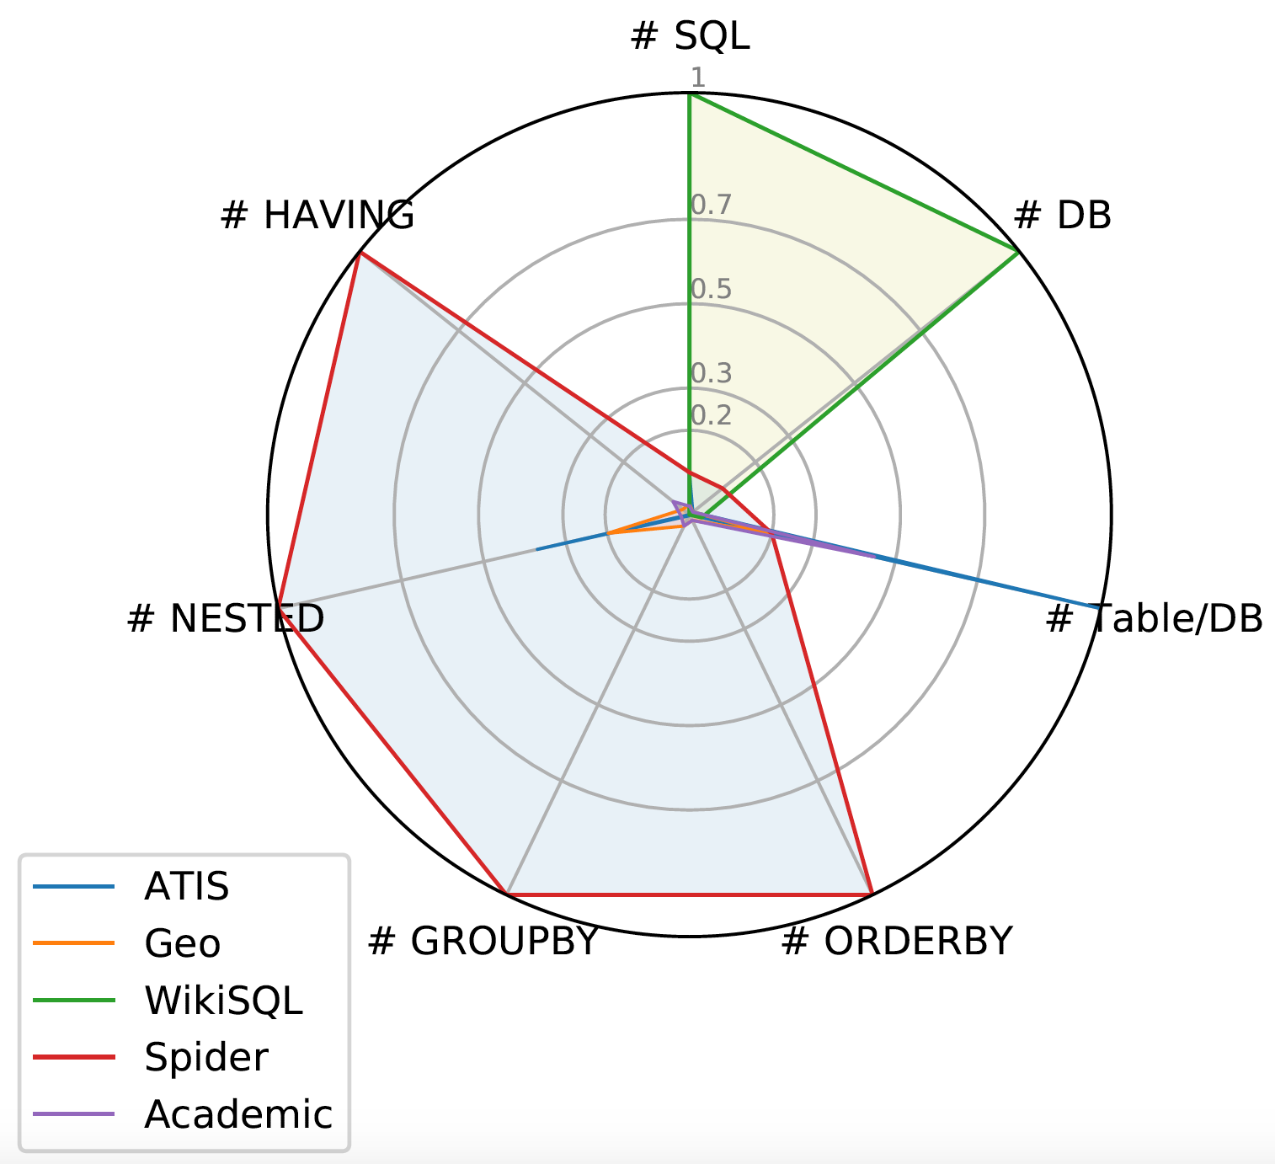
Seq2SQL data - Spider
WikiSQL is great. But it has limited
SQL coverage and a very simple
schema, which makes the
task simple and less interesting
[Yu et al. 2018]

Slide 79
Seq2SQL data - Yale Spider
SQL labels cover almost all important SQL components
Each database has multiple tables and several foreign keys
It is currently the only large-scale complex and cross-domain semantic parsing and text-to-SQL dataset!
Check it out!!!
Our Blog
Project Page: https://yale-lily.github.io/spider
Github Page: https://github.com/taoyds/spider

Slide 80
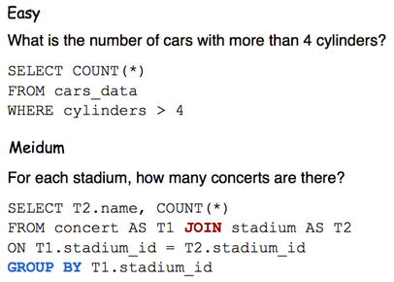
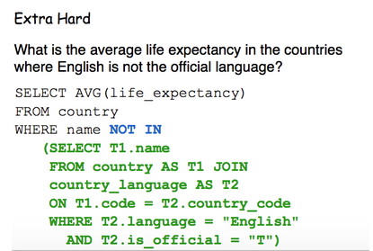
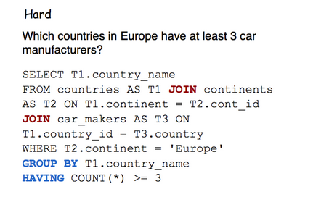
Query Difficulty

Slide 81
NLP

